Slide 1
Lorann game – Java Project
Presented by Origo Patrick-Ivann ,Bourthoumieux Thomas, Begue Mathieu , Chambefort Hugo

Slide 2
Distribution of roles
BOURTHOUMIEUX Thomas : Leader
ORIGO Patrick-Ivann: Developer
BEGUE Mathieu:
Developer
CHAMBEFORT Hugo:
Developer

Slide 3
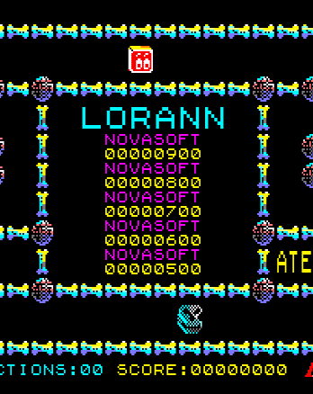
Plan : 1. Distribution of roles 2. Project management a)OBS b) GANTT c) PERT 3. MVC 4. Diagrams Example a) Package b) Class 6. Database part

Slide 4
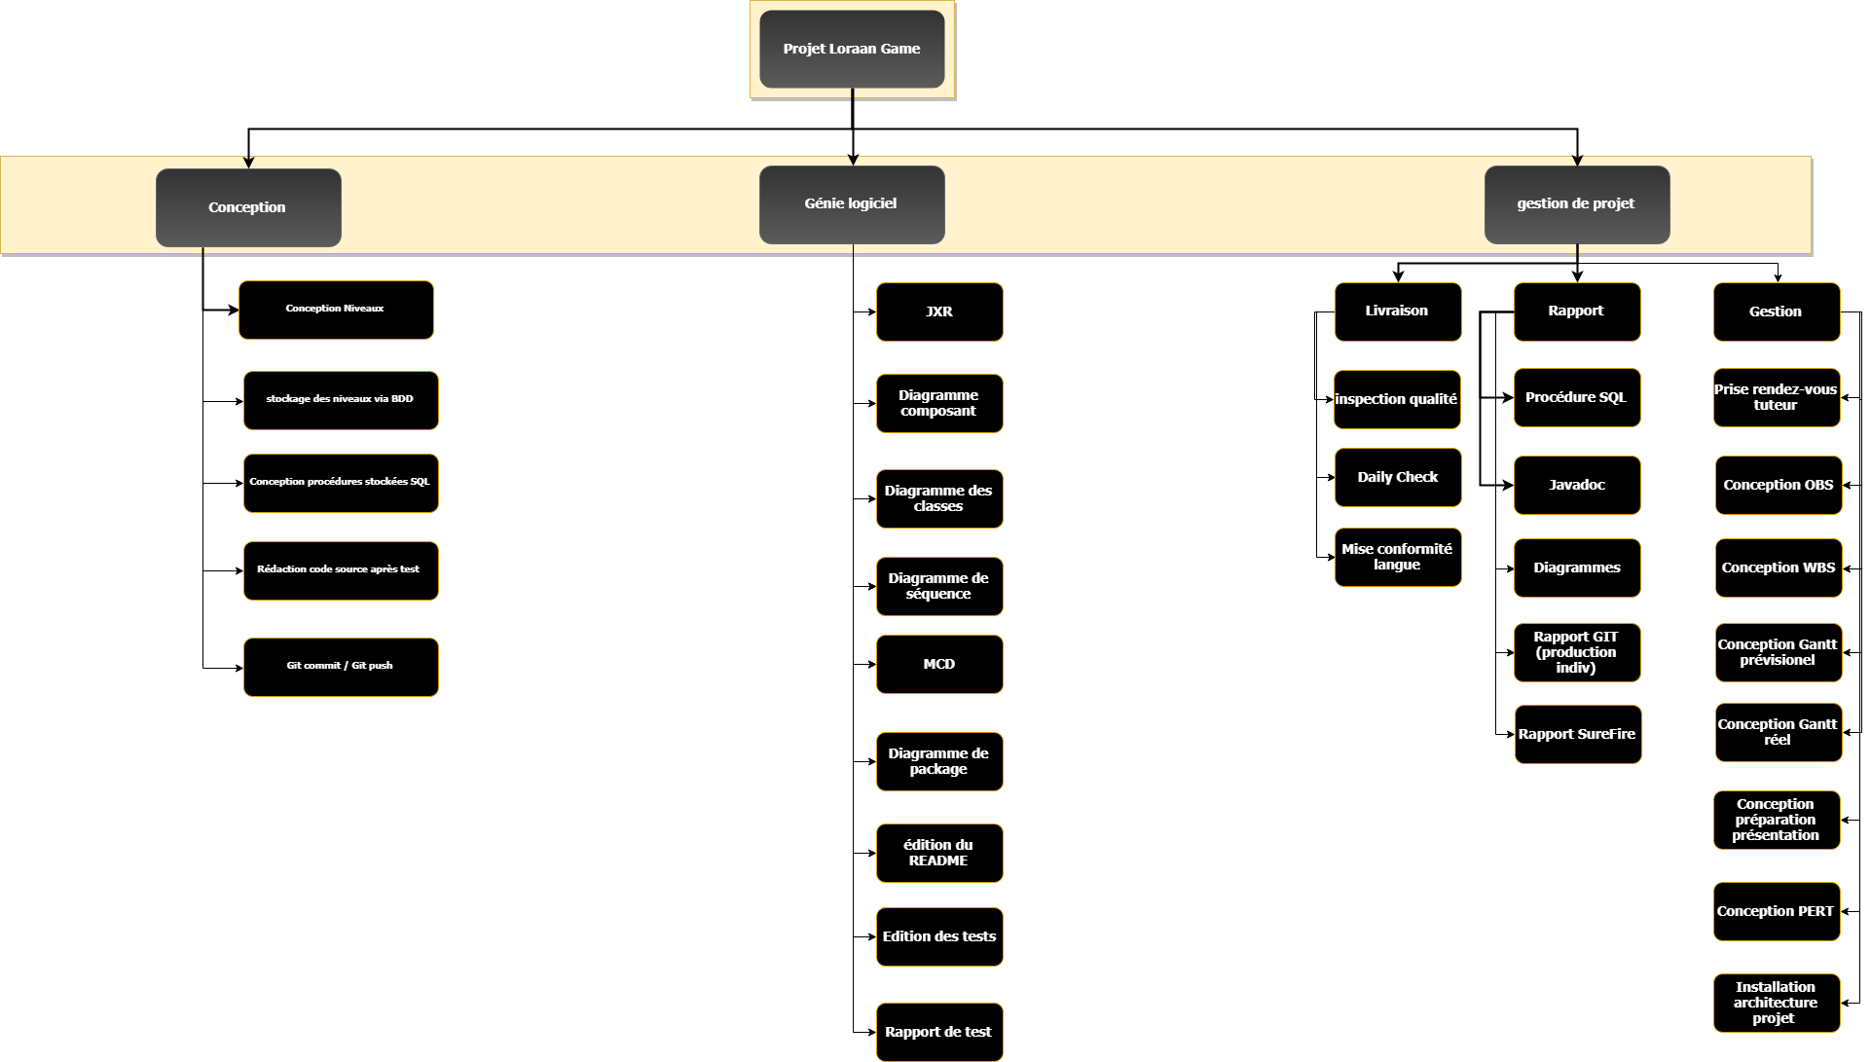
WBS

Slide 5
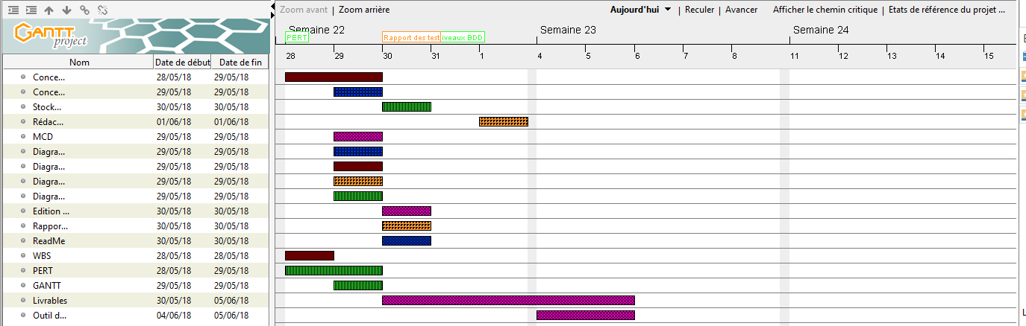
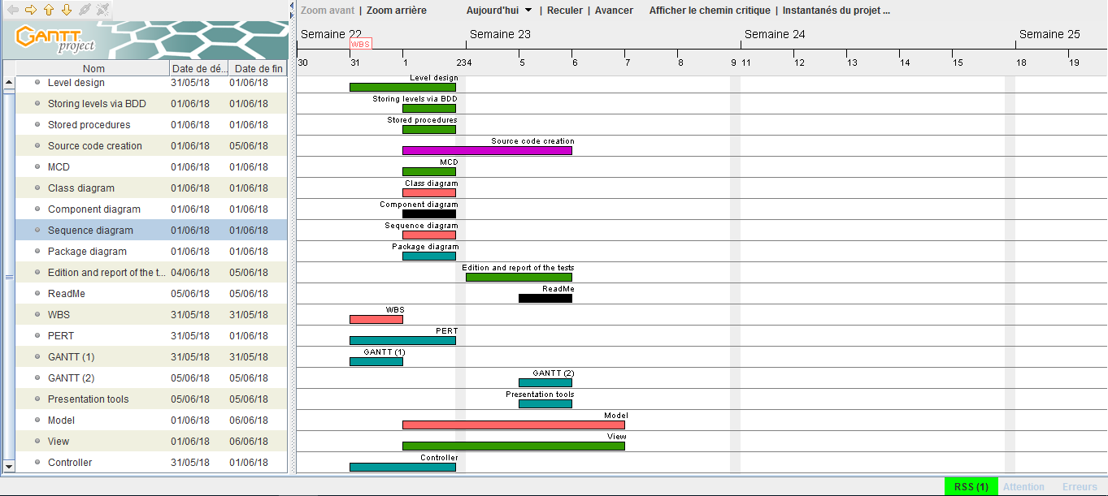
Project Management
1
2

Slide 6
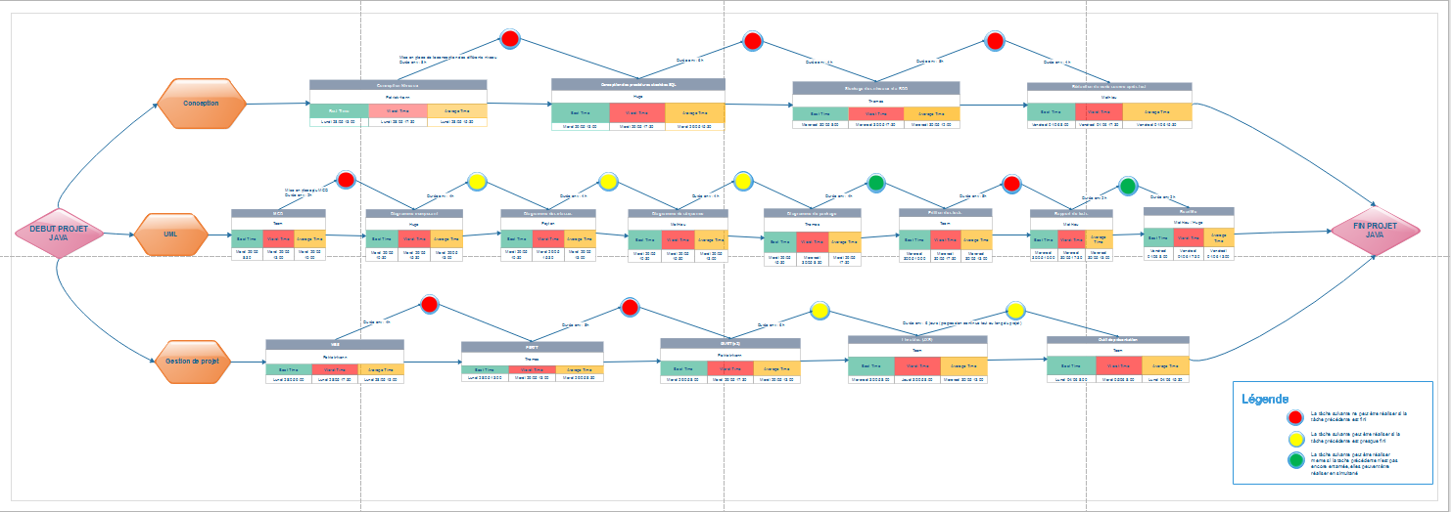
Pert

Slide 7
MVC
Sends a user request
Controller
Return to user
Request processing
View
Model
Sent as part of the request
Sent to be
presented to user

Slide 8
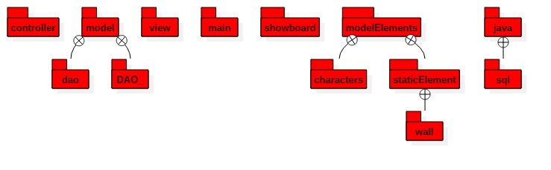
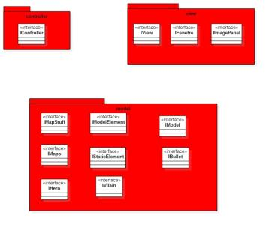
Package diagram
Contract package diagram

Slide 9

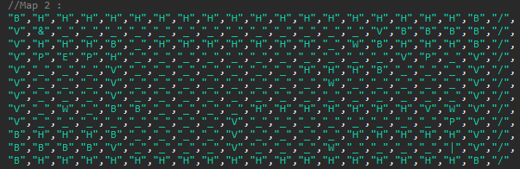
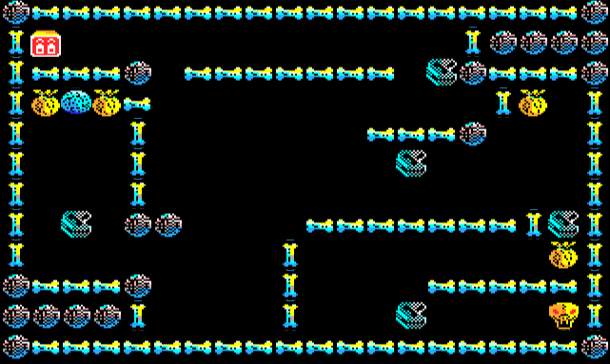
Database part

Slide 10

Thank you for your attention

